Slide 1
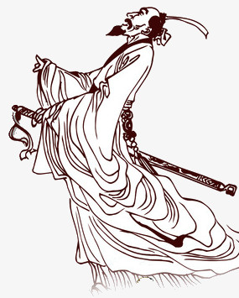
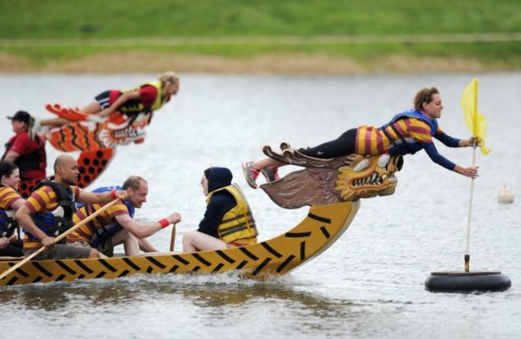
What do you do?
I’m a flag catcher.

Slide 2
a sachet
a dragon boat
stand an egg
a rice dumpling

Slide 4
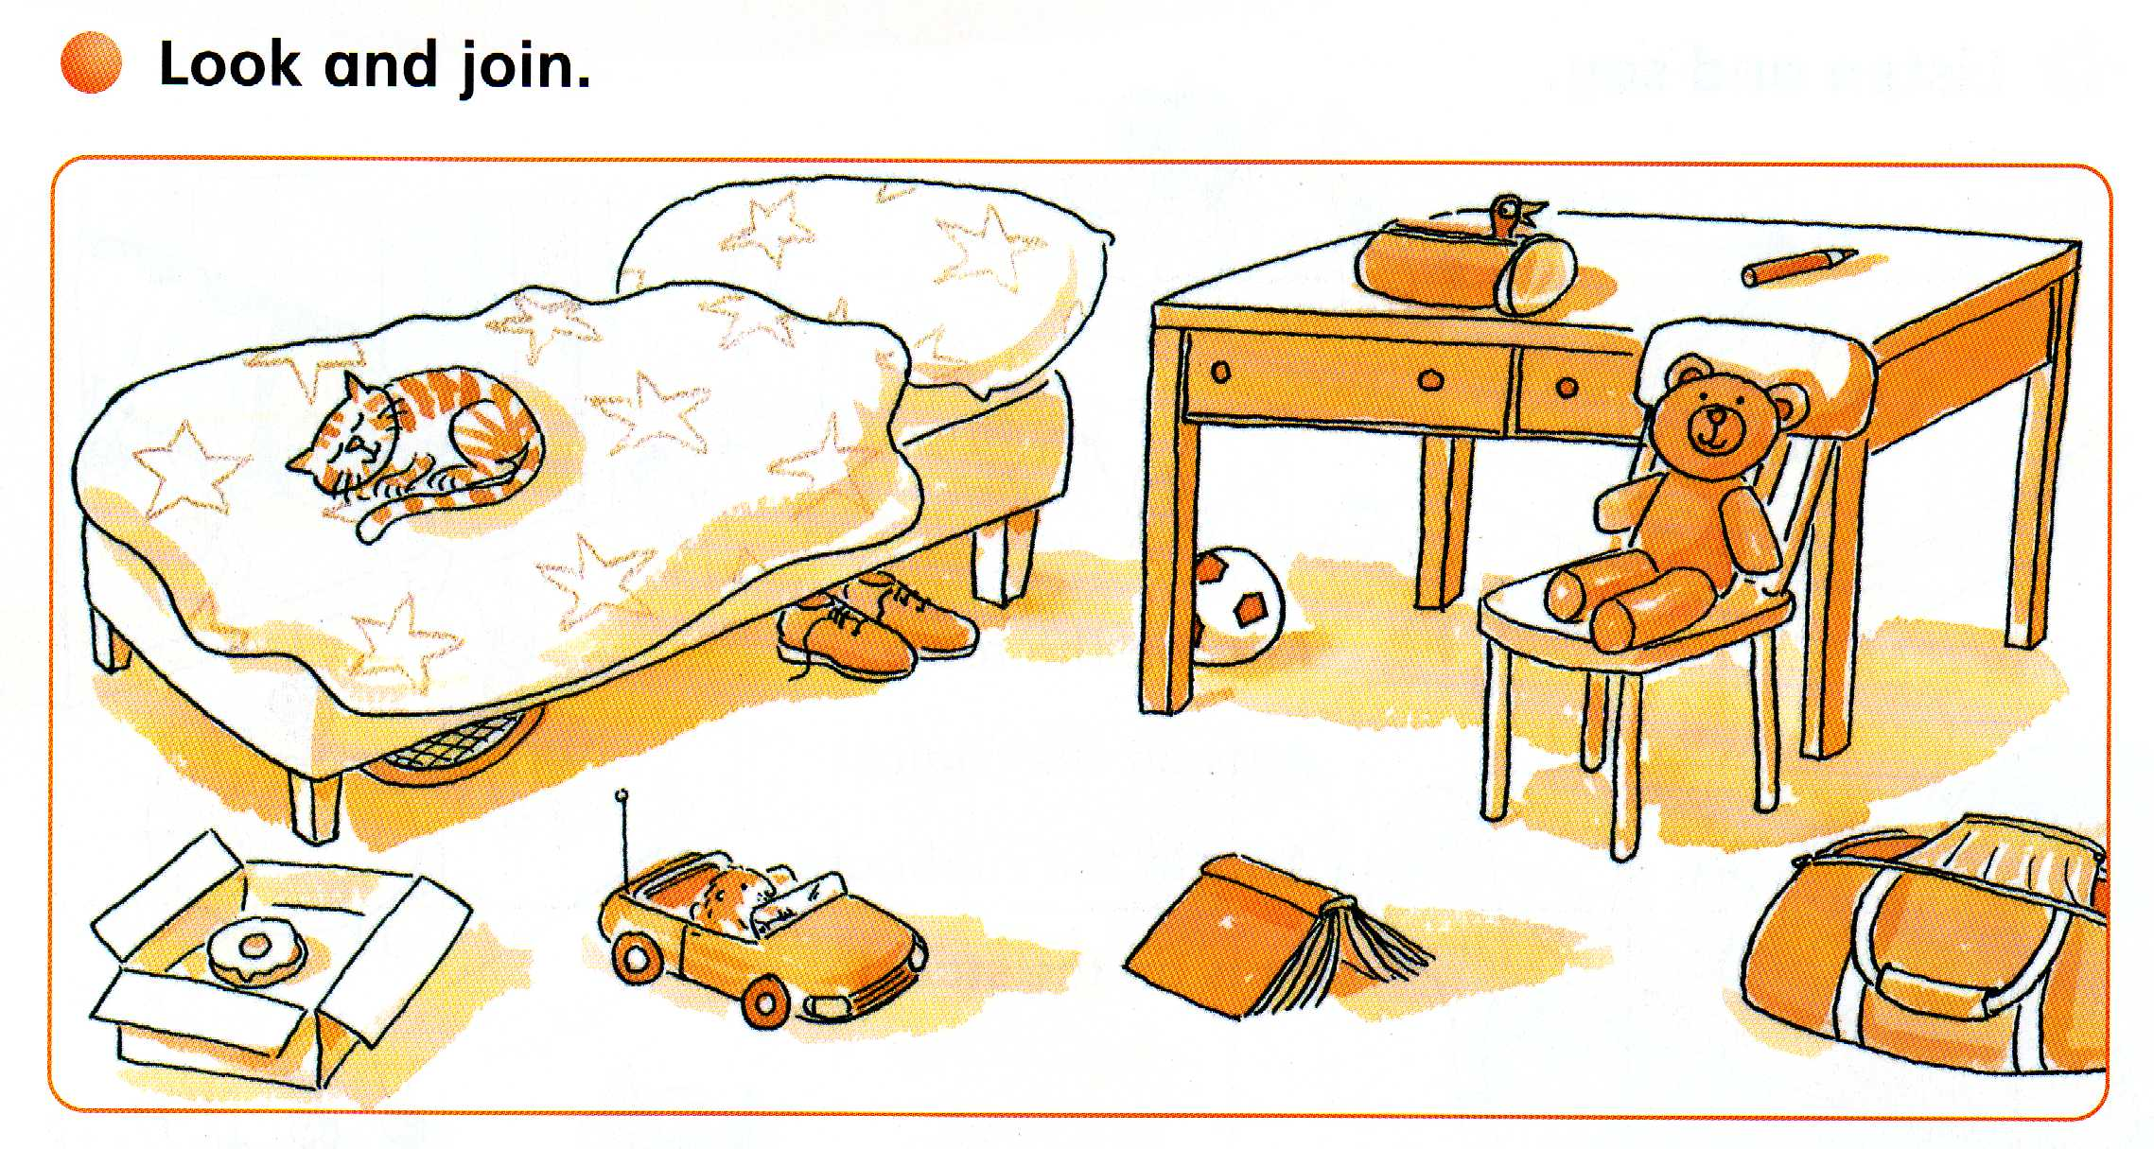

Slide 5
PLACE
PREPOSITIONS
in
in
The bird is ____ the pencil case.
under
on
next to

Slide 6
PLACE
PREPOSITIONS
in
on
The cat is _____ the bed.
under
on
next to

Slide 7
PLACE
PREPOSITIONS
in
The football is ______ the desk.
under
under
on
next to

Slide 8
PLACE
PREPOSITIONS
in
The shoes are ______ the bed.
under
under
on
next to

Slide 9
PLACE
PREPOSITIONS
in
The doughnut is ____ the box.
under
in
on
next to

Slide 10
PLACE
PREPOSITIONS
in
next to
The chair is ____ the desk.
under
on
next to

Slide 11
PLACE
PREPOSITIONS
in
under
on
The bag is ____
the floor.
on
next to

Slide 12
PLACE
PREPOSITIONS
in
The hamster is ____ the car.
under
in
on
next to

Slide 13
PLACE
PREPOSITIONS
in
The tennis racket is ______ the bed.
under
under
on
next to

Slide 14
PLACE
PREPOSITIONS
in
The box is ____ the bed.
under
next to
on
next to

Slide 15
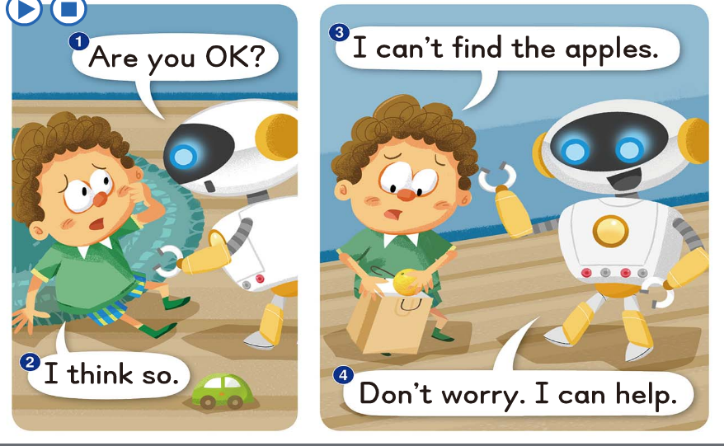

Slide 16
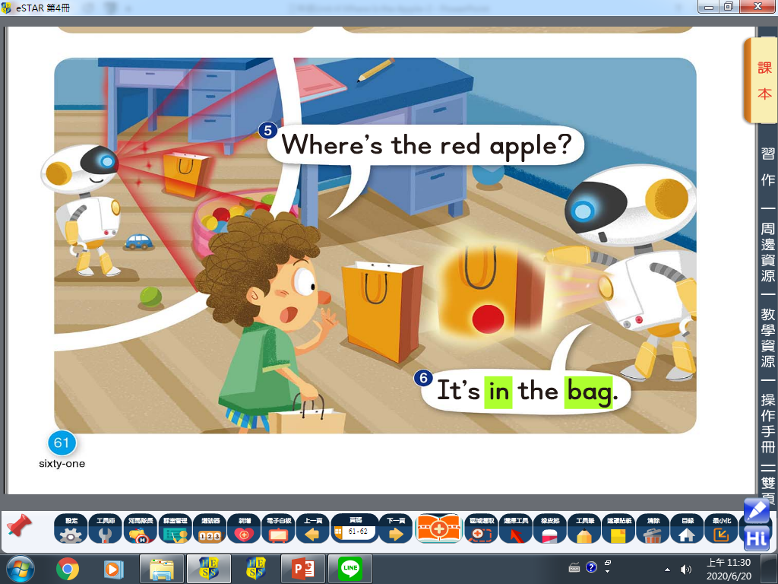

Slide 17
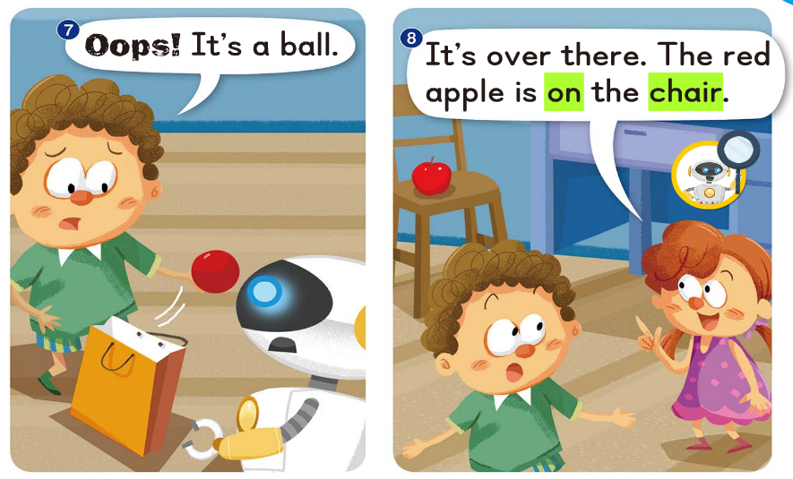

Slide 18
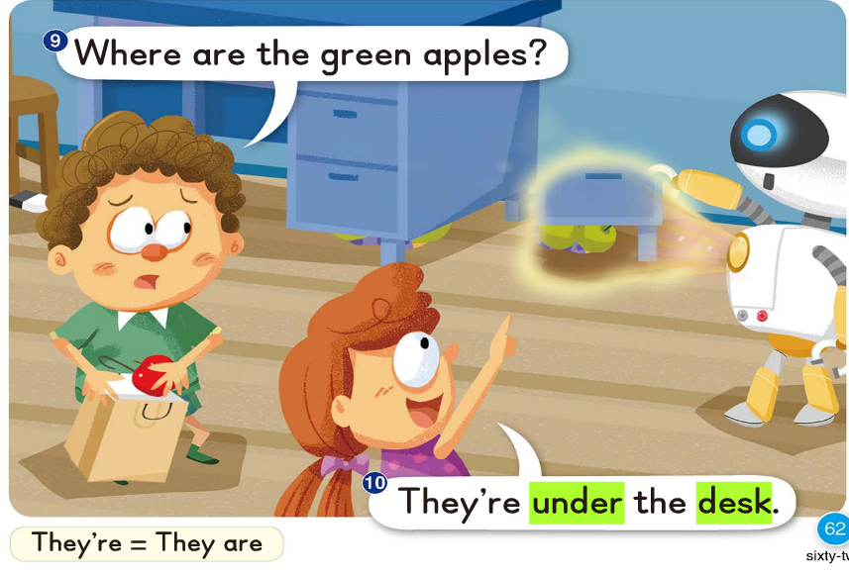

Slide 19
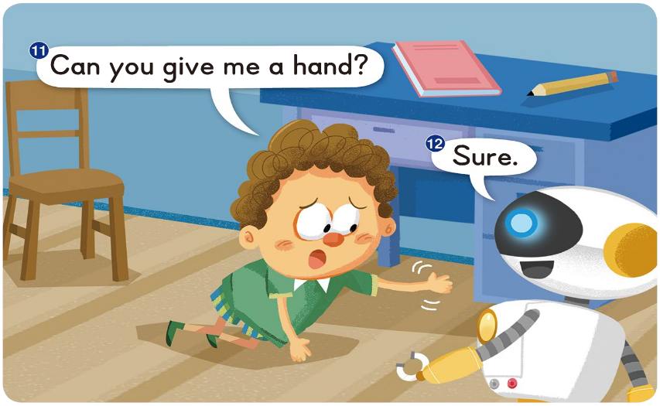

Slide 20
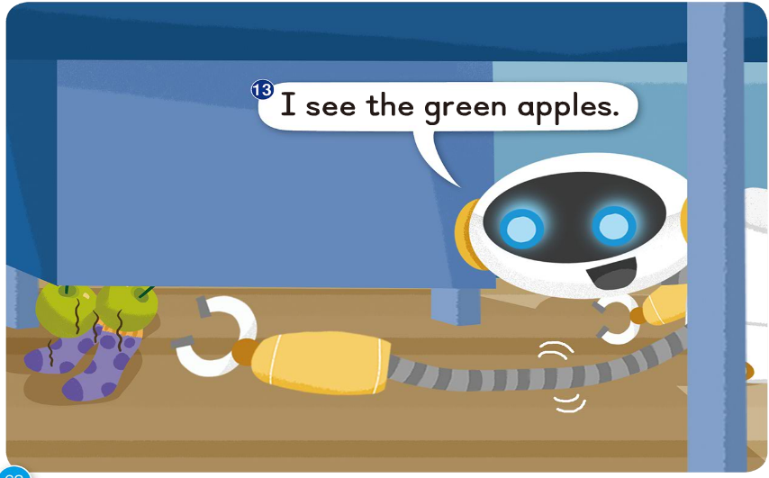

Slide 21
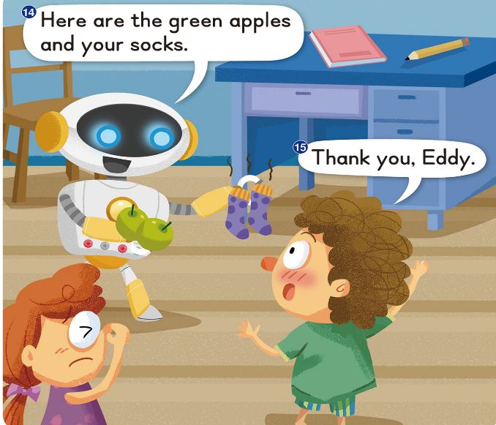

Slide 22
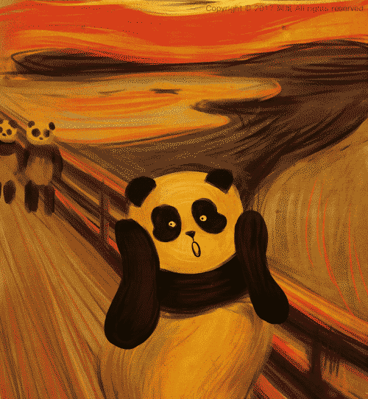

Slide 25
on
in
under
next to
under
on
in
next to
table
chair
desk
bag

Slide 27
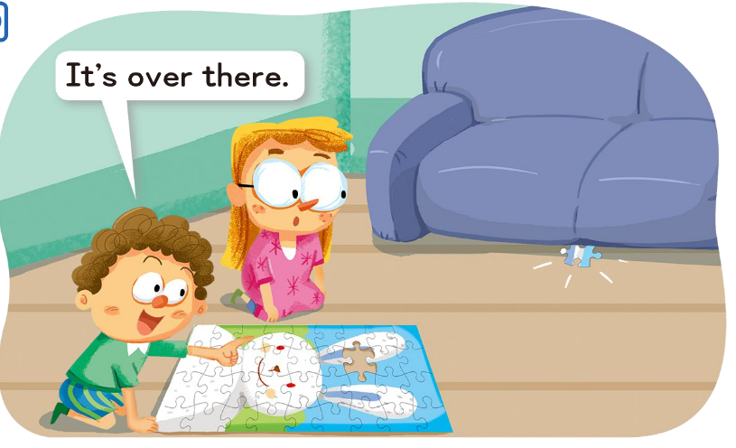
Daily Talk

Slide 28
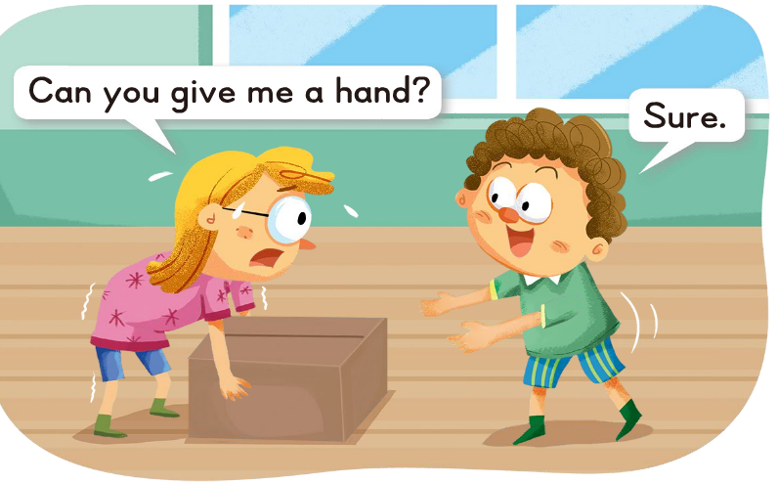
Daily Talk

Slide 29
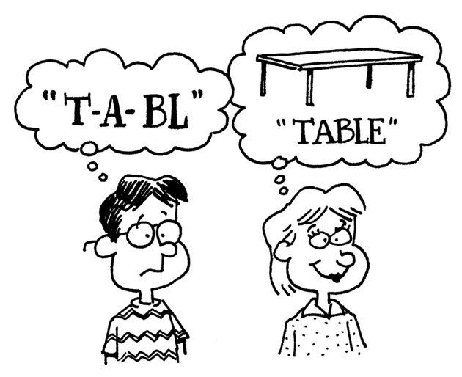
Phonics Time p71~72

Slide 30
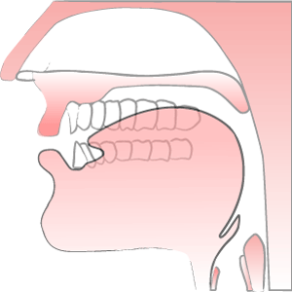
u
u
e

Slide 31
u

Slide 33
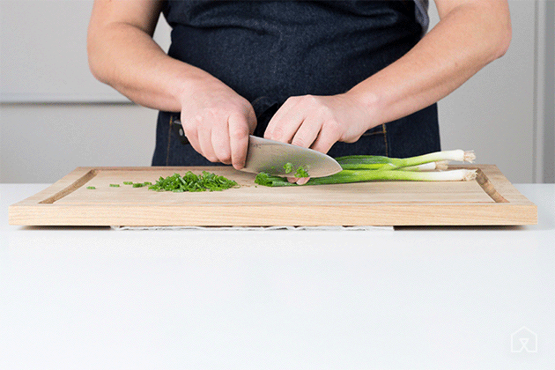
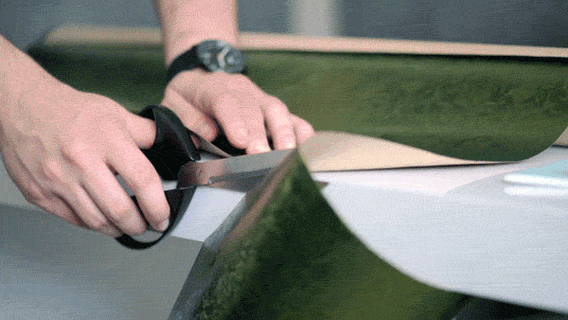
c
t
u

Slide 34
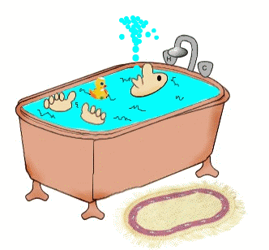
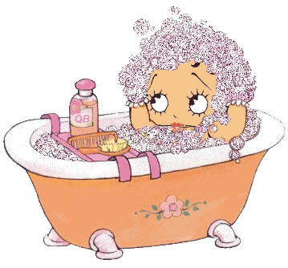
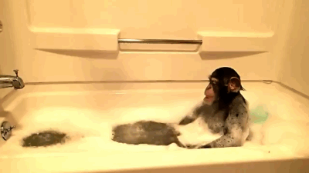
t
b
u

Slide 35
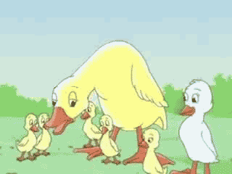
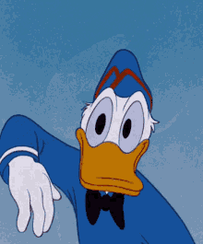
d
ck
u
ugly duckling
Donald Duck

Slide 36
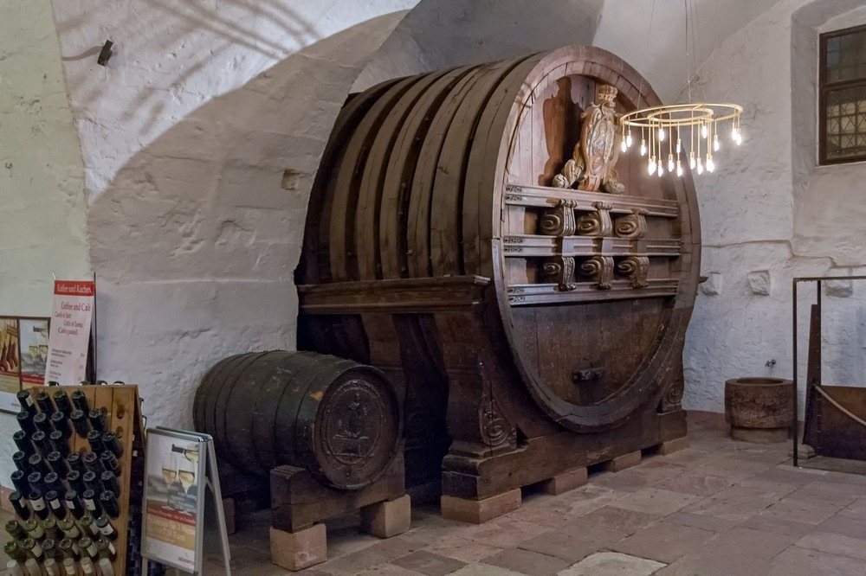
t
n
u

Slide 37
u
e

Slide 39
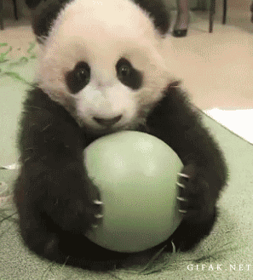
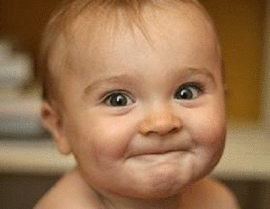
c
t
u
e

Slide 40
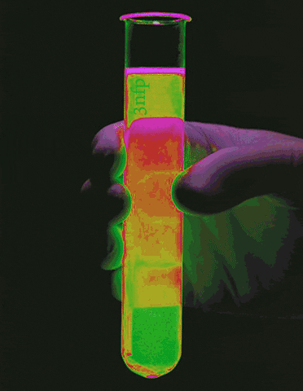
t
b
u
e

Slide 41
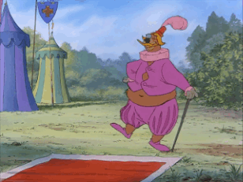
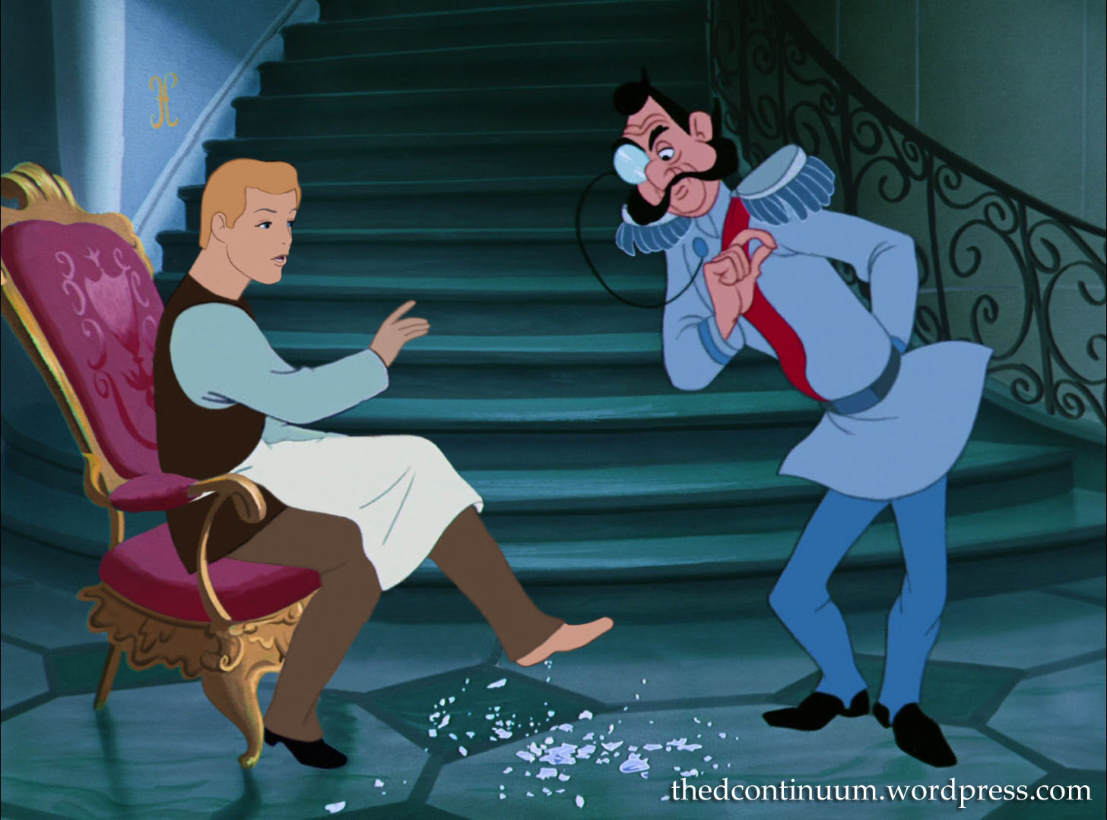
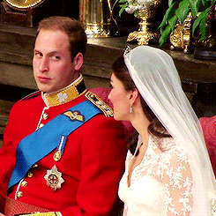
d
k
u
e

Slide 42
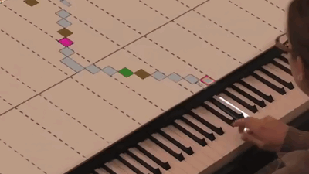
t
n
u
e
別轉台/敬請期待

Slide 44
A cube is in the tub.

Slide 45
The cute duck is by the tub.

Slide 46
The duck wants to get the cube.

Slide 47
They get wet in the tub.

Slide 48
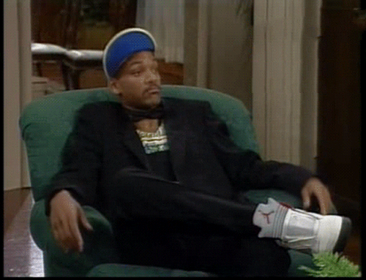
A cube is in the tub.
The cute duck is by the tub.
The duck wants to get the cube.
They get wet in the tub.

Slide 50
